Slide 1
ANGULAR
AMOL R PATIL PUNE

Slide 2
Components
Components are the main building blocks for Angular applications. Each component consists of:
An HTML template that declares what renders on the page
A TypeScript class that defines behavior
A CSS selector that defines how the component is used in a template
Optionally, CSS styles applied to the template
The Component contains the data and user interaction logic that define how the View looks and behaves. A view in Angular refers to a template (HTML).

Slide 3
An Angular component is a fundamental building block used to create the user interface and define the behavior of a section of a web application.
It's a reusable, self-contained piece of code that encapsulates a specific part of the user interface and its functionality.
Angular Component = HTML Template + Component Class + Component Metadata
Components are the fundamental building block for creating applications in Angular. By leveraging component architecture, Angular aims to provide structure for organizing your project into manageable, well-organized parts with clear responsibilities so that your code is maintainable and scalable

Slide 4
Template: This is the HTML markup that defines the structure of the component's view. It contains the layout, structure, and data bindings using Angular directives and interpolation.
Class (Component Class): The class is written in TypeScript and contains the logic, properties, and methods that define the behavior of the component. It interacts with the template, handles user events, manipulates data, and performs other functionalities.
Metadata: The metadata is defined using a decorator, typically @Component, which provides configuration options for the component. It includes information like the selector (the component's HTML tag), template or templateUrl (path to the HTML file), styles or styleUrls (CSS styles), and other settings.

Slide 5
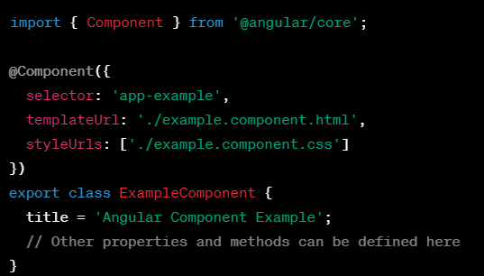

Components can be composed hierarchically, allowing developers to build complex applications by assembling smaller, reusable components together. They promote modularity, maintainability, and reusability of code, making it easier to manage different parts of the user interface in large-scale applications.

Slide 6
Creating a component using the Angular CLI
To create a component using the Angular CLI:
From a terminal window, navigate to the directory containing your application.
Run the ng generate component <component-name> command, where <component-name> is the name of your new component.
By default, this command creates the following:
A directory named after the component
A component file, <component-name>.component.ts
A template file, <component-name>.component.html
A CSS file, <component-name>.component.css
A testing specification file, <component-name>.component.spec.ts
Where <component-name> is the name of your component.

Slide 7
Creating a component Manually
Create the Component file.
Import the required external Classes/Functions.
Create the Component class and export it.
Add @Component decorator
Add metadata to @Component decorator
Create the Template
Create the CSS Styles
Register the Component in Angular Module

Slide 8
Create folder by name of component [e.g. student] add files student.component.html , student.component.ts
student.component.ts file
import { Component } from "@angular/core";
@Component({
selector:'app-student’, TAG
templateUrl:’./student.component.html’
})
export class StudentComponent
{
}
student.component.html file -- add some html

Slide 9
in app module ts file add new component
declarations: [
AppComponent,
StudentComponent
]
In app component html add new tag <app-student> </app-student>

Slide 10
Component Templates
The Template defines the layout and content of the View. Without the template, there is nothing for Angular to render to the DOM.
The Templates are only HTML codes and the Angular-specific special HTML markups (known as the Angular Template Syntax).
There are two ways you can specify the Template in Angular.
Defining the Template Inline
Provide an external Template

Slide 11
Component Class
The Class provides the data & logic to the View. It contains the Typescript code associated with Template (View). We use TypeScript to create the class.
Class Contains the Properties & Methods. The Properties of a class can be bound to the view using Data Binding.

Slide 12
Component Metadata
Metadata Provides additional information about the component of Angular. Angular uses this information to process the class. We use the @Component decorator to provide the Metadata to the Component.
selector - css selector that identifies this component in a template
styleUrls - list of urls to stylesheets to be applied to this component's view
styles - inline-defined styles to be applied to this component's view
template - inline-defined template for the view
templateUrl - url to an external file containing a template for the view

Slide 13
Standalone Component
A standalone component is a type of component that doesn’t belong to any specific Angular module.
Before Angular version 14, when you created a component, you typically had to include it in the declaration array of a module; otherwise, Angular would throw an error during compilation. However, starting from Angular version 14, you can create standalone components that are not tied to any specific module. In addition to components, you can also create standalone directives and pipes.
Simplify the Angular learning process by removing the NgModule concept, which can be challenging for developers new to Angular.
ng g c component_name --standalone

Slide 14
Data Binding
Data binding is a technique, where the data stays in sync between the component and the view. Whenever the user updates the data in the view, Angular updates the component. When the component gets new data, the Angular updates the view.
We use techniques like Interpolation, Property Binding, Event Binding & Two-Way Binding to bind data
The data binding in Angular can be broadly classified into two groups. One way binding or two-way binding
One way binding
In one way binding data flows from one direction. Either from view to component or from component to view.
From Component to View
To bind data from component to view, we make use of Interpolation & Property Binding

Slide 15
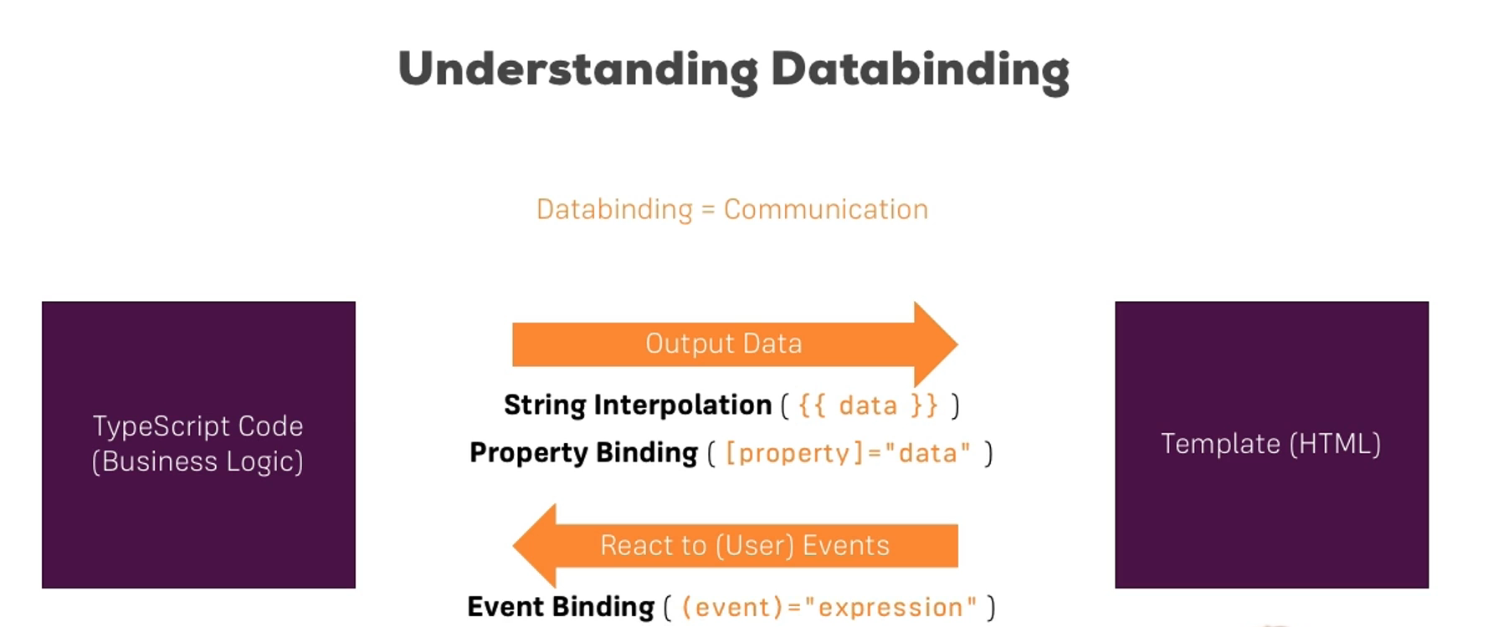

Slide 16
Interpolation
Interpolation allows us to include expressions as part of any string literal, which we use in our HTML. The angular evaluates the expressions into a string and replaces it in the original string and updates the view. You can use interpolation wherever you use a string literal in the view
The Angular uses the {{ }} (double curly braces) in the template to denote the interpolation. The syntax is as shown below
{{ templateExpression }}
The content inside the double braces is called Template Expression

Slide 17
Interpolation
Interpolation is one-way binding
Should not change state of an App [ can not use = operator ]
The expression must result in String
Works only on Properties and not on Attributes
Interpolation in Angular is a simple, yet powerful feature. It allows us to embed expressions in the string literal, Hence we can dynamically generate the string literal using the values from the component class.

Slide 18
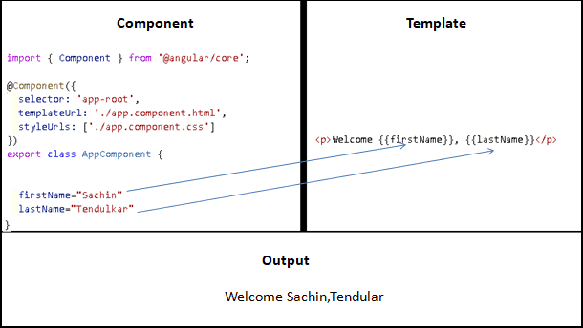
Interpolation

Slide 19

Property Binding
One-Way Binding: Property binding allows you to set an element's property based on the component's data.
Property binding moves a value in one direction, from a component's property into a target element property.
To bind to an element's property, enclose it in square brackets, [], which identifies the property as a target property.
A target property is the DOM property to which you want to assign a value.
In most cases, the target name is the name of a property, even when it appears to be the name of an attribute.
In this example, src is the name of the <img> element property.

Slide 20
[binding-target]=”binding-source”
The binding-target (or target property) is enclosed in a square bracket []. It should match the name of the property of the enclosing element.
The brackets, [], cause Angular to evaluate the right-hand side of the assignment as a dynamic expression. Without the brackets, Angular treats the right-hand side as a string literal and sets the property to that static value.
Binding-source is enclosed in quotes and we assign it to the binding-target. The Binding source must be a template expression. It can be property in the component, method in component, a template reference variable or an expression containing all of them.
Property binding is one way as values go from the component to the template. When the component values change, the Angular updates the view. But if the values changes in the view, the Angular does not update the component.
The binding expression should return the correct type. The type that the target property expects. Otherwise, it will not work

Slide 21
Property Binding
Property binding is one way as values go from the component to the template. When the component values change, the Angular updates the view
Should not change the state of the app
The binding expression should return the correct type. The type that the target property expects. Otherwise, it will not work
The brackets, [], tell Angular to evaluate the template expression. If you omit the brackets, Angular treats the expression as a constant string and initializes the target property with that string:
The property binding binds to the properties of DOM elements, components, and directives and not to HTML attributes. The angular has a special syntax for attribute binding.

Slide 22
Interpolation Vs Property Binding
Interpolation is a technique that allows the user to bind a value to a UI element. Interpolation binds the data one-way.
This means that when value of the field bound using interpolation changes, it is updated in the page as well.
Angular uses double-curly braces {{ }} to represent interpolation. Interpolation executes expression.
We can use interpolation for :
Performing calculations String Concatenations
JavaScript functions (propertyname.length, propertyname.toUpperCase (), etc…)
Call a method in component class from a template.

Slide 23
Interpolation Vs Property Binding
Everything that can be done from interpolation can also be done using the Property binding.
Interpolation is actually a shorthand for binding to the textContent property of an element.
Angular automatically translates interpolations into the corresponding property bindings before rendering the view.
Interpolation requires the expression to return a string. If you want to set an element property to a non-string data value, you must use property binding
<h1> {{ title }} </h1>
<h1 [innerText]="title"></h1>

Slide 24
Interpolation Vs Property Binding
Property Binding is used to bind property of HTML element
It is also one way binding like interpolation
Difference between Interpolation and Property Biding
Where to use Interpolation?
In some cases like when we need to concatenate strings we have to use interpolation instead of property binding.
Check this example. <img src=’www.angulartric.com/{{imagePath}}’ />
Where to use Property binding?
When setting an element property to a non-string data value, you must use property binding.
In the following example, we are disabling a button by binding to the boolean property isDisabled. <button [disabled]=’isDisabled’>Click me</button>
If we use interpolation instead of property binding, the button is always disabled irrespective of isDisabled class property value. <button disabled='{{isDisabled}}’>Click me</button> (this doesn’t work).

Slide 25

Event Binding
One-Way Binding: Event binding allows you to listen for events triggered by the user (such as clicks, key presses, etc.) and execute functions in the component class.

Slide 26
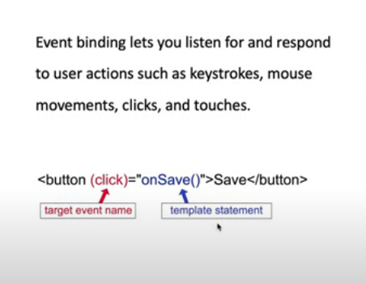
Event Binding
It is one way from view to component
By tracking the user events in the view and responding to it, we can keep our component in sync with the view.
For Example, when the user changes to an input in a text box, we can update the model in the component, run some validations, etc. When the user submits the button, we can then save the model to the backend server.
(click) --- on-click
Unlike the Property Binding & Interpolation, where we use the template expression is used, in the case of event binding we use template statement.
The Template statement can change the state of the component. Angular runs the change detection and updates the view so as to keep it in sync with the component

Slide 27
Event - $event
DOM Events carries the event payload. i.e the information about the event.
We can access the event payload by using $event as an argument to the handler function.
<input (input)="handleInput($event)">
<p>You have entered {{value}}</p>
value=""
handleInput(event) {
this.value = (event.target as HTMLInputElement).value;
}

Slide 28
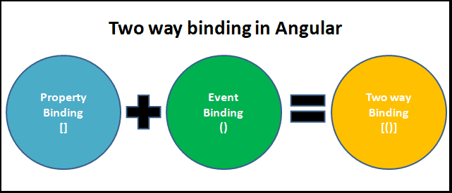
Two Way Data Binding
Two-way binding means changes made to Model in the component are propagated to the view and that changes made in the view are immediately updated in the underlying component data
Two-way data binding is useful in data entry forms. Whenever a user makes changes to a form field, we would like to update our model. Similarly, when we update the model with new data, we would like to update the view as well

Slide 29
Syntax : <someElement [(someProperty)]="value"></someElement>
Note that both square & parentheses are used here. This is now known as Banana in a box syntax. The square indicates the Property binding & parentheses indicates the event binding.
The two-way binding is a simple, but yet powerful mechanism. We use Property binding & Event binding to achieve the two-way binding. Angular does have a [(value)] syntax to which sets up the two-way binding. It automatically sets up property binding to the value property of the element. It also sets up the event binding to valueChange Property. But since we hardly have any HTML element, which follows those naming conventions unless we create our own component. This is where ngModel directive from FormsModule steps in and provides two way binding to all the known HTML form elements.

Slide 30
ngModel
ngModel is an Angular directive used for two-way data binding in forms. It's a part of the FormsModule or ReactiveFormsModule in Angular, allowing developers to bind form controls to a component's property.It binds form elements like text, select etc.
Internally It uses the ngModel in property binding to bind to the value property and ngModelChange which binds to the input event.
The ngModel directive is not part of the Angular Core library. It is part of the FormsModule library. You need to import the FormsModule package into your Angular module.
<input type="text" name="value" [(ngModel)]="value">

Slide 31
What is template reference variable ?
The template reference variable is a reference to any DOM element, component or a Directive.
It can contain reference to h1, div etc.
<h1>{{title}}</h1>
<p>
<label for="firstName">First Name</label>
<input (keyup)="0" type="text" #firstName id="firstName">
</p>
<p>
<label for="lastName">Last Name</label>
<input (keyup)="0" type="text" #lastName id="lastName">
</p>
<b>Welcome {{firstName.value}} {{lastName.value}} </b>

Slide 32
What is template reference variable ?
Template variables help you use data from one part of a template in another part of the template. Use template variables to perform tasks such as respond to user input or finely tune your application's forms.
A template variable can refer to the following:
a DOM element within a template
a directive or component
a TemplateRef from an ng-template
a web component
<input #phone placeholder="phone number" />
<!-- lots of other elements -->
<!-- phone refers to the input element; pass its `value` to an event handler -->
<button type="button" (click)="callPhone(phone.value)">Call</button>

Slide 33
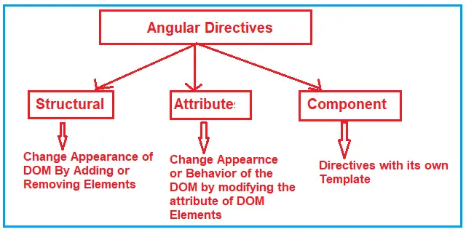
Angular Directive
The Angular Directives are the elements which are basically used to change the behavior or appearance or layout of the DOM (Document Object Model) element. In other words, we can say that the directives are basically used to extend the power of HTML attributes and to change the appearance or behavior of a DOM element.

Slide 34
Angular Directives
Directives are used to manipulate DOM
You can change DOM element’s appearance, behavior or layout using the directives
Types of Directives : Structural, Component, Attribute
Structural Directives : ngFor, ngIf, ngSwitch
Attribute Directive : ngClass, ngStyle
Structural directives can change the DOM layout by adding and removing DOM elements. All structural Directives are preceded by Asterix symbol

Slide 35
Structural Directive
The Structural Directives are responsible for the HTML layout.
That means, they will shape or reshape the HTML view by simply adding or removing the elements from the DOM. These directives are basically used to handle how the component or the element should render in a template.
NgFor (*ngFor)
NgIf (*ngIf)
NgSwitch (*ngSwitch)

Slide 36
Structural Directives - ngFor
Angular ngFor directive iterates over a collection of data like an array, list, etc, and creates an HTML element for each of the items from an HTML template. It helps us to build lists or tables to display tabular data in a nice way.
<html-element ngFor="let <item> of <items>;”>
<html-Template></html-Template>
</html-element>
<ul>
<li *ngFor="let movie of movies"> movies is an array
{{ movie.title }} - {{movie.director}}
</li>
</ul>

Slide 37
Structural Directives - ngFor
ngFor exposes several values, which help us to fine-tune display. We assign these values to the local variable and use it in our template
index: number: The zero-based index of the current element in the collection.
count: number: The total no of items in the collection
first: boolean: True when the item is the first item in the collection.
last: boolean: Is set to True, when the item is the last item in the collection.
even: boolean: True when the item has an even index in the collection.
odd: boolean: is set to True when the item has an odd index in the collection.

Slide 38
Track By
Track By clause allows you to specify your own key to identify objects.
Angular uses the object identity to compare the elements in the collection to the DOM nodes. Hence when you add an item or remove an item, the Angular will track it and update only the modified items in the DOM. It does not render the entire list
We should always specify the primary key or unique key as the trackBy clause.
<tr *ngFor="let movie of movies; trackBy:trackByFn;">
trackByFn(index, item) {
return item.title;
}

Slide 39
Structural Directives - ngSwitch
The ngSwitch directive lets you add/remove HTML elements depending on a match expression. ngSwitch directive used along with ngSwitchCase and ngSwitchDefault
<div [ngSwitch]="num">
<div *ngSwitchCase="'1'">One</div>
<div *ngSwitchCase="'2'">Two</div>
<div *ngSwitchCase="'3'">Three</div>
<div *ngSwitchCase="'4'">Four</div>
<div *ngSwitchCase="'5'">Five</div>
<div *ngSwitchDefault>This is Default</div>
</div>

Slide 40
Structural Directives - ngSwitch
You must place ngSwitchCase & ngSwitchDefault inside the ngSwitch directive
Angular displays every element, that matches the switch_expression
If there are no matches, angular displays all the elements, which has ngSwitchDefault directive
You can place one or more than one ngSwitchDefault anywhere inside the container element and not necessarily at the bottom.
Any element within the ngSwitch statement but outside of any NgSwitchCase or ngSwitchDefault directive is displayed as it is.
The elements are not hidden but removed from the DOM.
Angular uses loose equality checks to compare the ngSwitchCase expression with the ngSwitch expression. This means that the empty string "" matches 0.
You can share the template between multiple ngSwitchCase using the ngTemplateOutlet

Slide 41
Structural Directives - ngIf
The ngIf Directives is used to add or remove HTML elements based on an expression. The expression must return a boolean value. If the expression is false then the element is removed, else the element is inserted
<p *ngIf="condition">
content to render when the condition is true
</p>

Slide 42
Hidden attribute Vs ngIf
ngIf does not hide the DOM element. It removes the entire element along with its subtree from the DOM. It also removes the corresponding state freeing up the resources attached to the element.
The hidden attribute does not remove the element from the DOM. But hides it
<p [hidden]="condition">
content to render, when the condition is true
</p>

Slide 43
What is ngTemplate ?
ng-template falls under the category of structural directives, which help us define a template that doesn’t render anything by itself, but conditionally renders them to the DOM.
It helps us create dynamic templates that can be customized and configured.
As the name suggests the <ng-template> is a template element that Angular uses with structural directives (*ngIf, *ngFor, [ngSwitch] and custom directives).

Slide 44
Attribute Directive
Attribute Directives are basically used to modify the behavior or appearance of the DOM element or the Component. In Angular, there are two in-built attribute directives available. They are as follows:
NgStyle: This NgStyle Attribute Directive is basically used to modify the element appearance or behavior.
NgClass: This NgClass Attribute Directive is basically used to change the class attribute of the element in the DOM or in the Component to which it has been attached.

Slide 45
ngClass, ngStyle
ngClass is used the add conditional class to a HTML element.
The syntax is <element [ngClass]="expression">...</element>
The expression must return a string, array, or object.
The Angular ngStyle directive allows us to set the many inline style of a HTML element using an expression.
<input [(ngModel)]="color" />
<div [ngStyle]="{'color': color}">Change my color</div>

Slide 46
Angular Pipes
Pipes are simple functions to use in template expressions to accept an input value and return a transformed value.
DatePipe: Formats a date value according to locale rules.
UpperCasePipe: Transforms text to all upper case.
LowerCasePipe: Transforms text to all lower case.
CurrencyPipe: Transforms a number to a currency string, formatted according to locale rules.
DecimalPipe: Transforms a number into a string with a decimal point, formatted according to locale rules.
PercentPipe: Transforms a number to a percentage string, formatted according to locale rules.
AsyncPipe: Subscribe and unsubscribe to an asynchronous source such as an observable.
JsonPipe: Display a component object property to the screen as JSON for debugging.

Slide 47
Angular Pipes
Angular Pipes takes data as input and formats/transform the data to display in the template
The Angular has several built-in pipes, which you can use in your application.
Some of the important pipes are Date Pipe, Uppercase Pipe, Lowercase Pipe, Number Pipe/ Decimal Pipe, Currency Pipe, and Percent Pipe, etc
Expression | pipeOperator[:pipeArguments]
e.g. {{toDate | date:’medium’}}
Medium is an argument to pipe , date is std format, toDate is data

Slide 48
Creating Custom Pipes
Create a pipe class
Decorate the class with @pipe decorator.
Give a name to the pipe in the name meta data of the @pipe decorator. We will use this name in the template.
The pipe class must implement the PipeTransform interface. The interfaces contain only one method transform.
The first parameter to the transform method is the value to be transferred. The transform method must transform the value and return the result. You can add any number of additional arguments to the transform method.
Declare the pipe class in the Angular Module (app.module.ts)
Use the custom pipe just as you use other pipes.

Slide 49
Component Communication
If the Components have a parent-child relationship then, then the parent component can pass the data to the child using the @input Property.
Create a property (someProperty) in the Child Component and decorate it with @Input(). This will mark the property as input property
export class ChildComponent {
@Input() someProperty: number;
}
And in the Parent Component Instantiate the Child Component. Pass the value to the someProperty using the Property Bind Syntax
<child-component [someProperty]=value></child-component>`

Slide 50
Child to Parent Communication
Listens to Events from Child
The Child Component exposes an EventEmitter Property. This Property is adorned with the @Output decorator. When Child Component needs to communicate with the parent it raises the event. The Parent Component listens to that event and reacts to it.

Slide 51
Child to Parent Communication
The Angular Component Output Properties are used to to pass the data from the nested component to the container component.
@Output Decorator - Using the EventEmitter Property gives the components ability to raise an event. But to make that event accessible from parent component, must decorate the property with @Output decorator.
How to Pass data to parent component using @Output
Child Component
Declare a property of type EventEmitter and instantiate it.
Mark it with a @Output Decorator.
Raise the event passing it with the desired data
Parent Component
Bind to the Child Component using Event binding and listen to the child events.
Define the event handler function.

Slide 52
Child to Parent Communication
Listens to Events from Child
The Child Component exposes an EventEmitter Property. This Property is adorned with the @Output decorator. When Child Component needs to communicate with the parent it raises the event. The Parent Component listens to that event and reacts to it.
How to Pass data to parent component using @Output
In the child component
Declare a property of type EventEmitter and instantiate it
Mark it with a @Output Decorator
Raise the event passing it with the desired data
In the Parent Component
Bind to the Child Component using Event Binding and listen to the child events
Define the event handler function

Slide 53
Parent uses local variable to access the Child in Template
import { Component} from '@angular/core';
@Component({
selector: 'child-component',
template: `<h2>Child Component</h2>
current count is {{ count }}
`
})
export class ChildComponent {
count = 0;
increment() {
this.count++;
}
decrement() {
this.count--;
}
}
import { Component} from '@angular/core';
@Component({
selector: 'app-root',
template: `
<h1>{{title}}!</h1>
<p> current count is {{child.count}} </p>
<button (click)="child.increment()">Increment</button>
<button (click)="child.decrement()">decrement</button>
<child-component #child></child-component>` ,
styleUrls: ['./app.component.css']
})
export class AppComponent {
title = 'Parent interacts with child via local variable';
}
We have created a local variable, #child, on the tag <child-component>. The “child” is called template reference variable, which now represents the child component
The Template Reference variable is created, when you use #<varibaleName> and attach it to a DOM element. You can then, use the variable to reference the DOM element in your Template

Slide 54
Parent uses a @ViewChild() to get reference to the Child Component
Injecting an instance of the child component into the parent as a @ViewChild is the another technique used by the parent to access the property and method of the child component
The @ViewChild decorator takes the name of the component/directive as its input. It is then used to decorate a property. The Angular then injects the reference of the component to the Property
For Example
@ViewChild(ChildComponent) child: ChildComponent;

Slide 55
import { Component, ViewChild } from '@angular/core';
import { ChildComponent } from './child.component';
@Component({
selector: 'app-root',
template: `
<h1>{{title}}</h1>
<p> current count is {{child.count}} </p>
<button (click)="increment()">Increment</button>
<button (click)="decrement()">decrement</button>
<child-component></child-component>` ,
styleUrls: ['./app.component.css']
})
export class AppComponent {
title = 'Parent calls an @ViewChild()';
@ViewChild(ChildComponent) child: ChildComponent;
increment() {
this.child.increment();
}
decrement() {
this.child.decrement();
}
}

Slide 56
Parent Child Communication
The Parent can subscribe to the events of the child component.
It can use the Template local variable to access the properties and methods.
We can also use @ViewChild decorator to inject the child component instance to the parent

Slide 57
Communication when there is no relation
Communication when there is no relation
If the Components do not share the Parent-child relationship, then the only way they can share data is by using the services and observable.
The advantageous of using service is that
You can share data between multiple components.
Using observable, you can notify each component, when the data changes.

Slide 58
Component Life Cycle Hooks
The life cycle hooks are the methods that angular invokes on the directives and components as it creates, changes, and destroys them.
Using lifecycle hooks we can fine-tune the behavior of our components during its creation, updating, and destruction.
When the angular application starts, it creates and renders the root component. It then creates and renders its Children & their children. It forms a tree of components.
The Angular life cycle hooks are nothing but callback functions, which angular invokes when a specific event occurs during the component’s life cycle.

Slide 59
Change detection is the mechanism by which angular keeps the template in sync with the component
The life cycle of a component begins when Angular creates the component class. The first method that gets invoked is class Constructor.
Constructor is neither a life cycle hook nor is it specific to Angular. It is a Javascript feature. It is a method that is invoked when a class is created.
Angular makes use of a constructor to inject dependencies.
At this point, none of the component’s input properties are available. Neither its child components are constructed. Projected contents are also not available.
Hence there is little you can do with this method. And also, it is recommended not to use it
Once Angular instantiates the class, It kick-starts the first change detection cycle of the component.

Slide 60
ngOnChanges
The Angular invokes the ngOnChanges life cycle hook whenever any data-bound input property of the component or directive changes.
Input properties are those properties which we define using the @Input decorator. It is one of the ways by which a parent communicates with the child component.
Child Component @Input() message:string
Parent Component <app-child [message]="message"> </app-child>
The change detector checks if the parent component changes such input properties of a component. If it is, then it raises the ngOnChanges hook.
We use this life cycle hook in Passing data to the child component.

Slide 61
ngOnInit
The Angular raises the ngOnInit hook after it creates the component and updates its input properties. It raises it after the ngOnChanges hook.
This hook is fired only once and immediately after its creation (during the first change detection)
This is a perfect place where you want to add any initialization logic for your component. Here you have access to every input property of the component. You can use them in HTTP get requests to get the data from the back-end server or run some initialization logic etc.

Slide 62
ngOnCheck
Detect and act upon changes that Angular can't or won't detect on its own.
Called during every change detection run, immediately after ngOnChanges() and ngOnInit().
This lifecycle hook is executed during every change detection cycle and is a good place to perform custom change detection.

Slide 63
ngAfterContentInit , ngAfterContectChecked
ngAfterContentInit: This lifecycle hook is executed after the component's content has been initialized and is a good place to perform additional setup for the component's content.
ngAfterContentChecked: This lifecycle hook is executed after the component's content has been checked and is a good place to perform additional operations based on the component's content.

Slide 64
ngAfterViewInit , ngAfterViewChecked
ngAfterViewInit: This lifecycle hook is executed after the component's view has been initialized and is a good place to perform additional setup for the component's view.
ngAfterViewChecked: This lifecycle hook is executed after the component's view has been checked and is a good place to perform additional operations based on the component's view.

Slide 65
ngOnDestroy
This lifecycle hook is executed just before the component is destroyed and is a good place to perform cleanup operations for the component.

Slide 66
Angular Forms
Angular takes two approaches to build the forms. One is Template-driven forms approach and another one is Reactive forms or model-driven forms approach
In Template-driven approach is the easiest way to build the Angular forms. The logic of the form is placed in the template. The approach here is similar to what we did in AngularJs
In Reactive Forms or Model-driven approach, the logic of the form is defined in the component as an object. The Model-driven approach has more benefits as it makes the testing of the component easier.

